Slide 1

DevNet Use Case
Automation in Manufacturing
Derek S. Winchester Daren Fulwell
Verizon Manchester Airports Group
@derekwtp @init6_network @darenfulwell

Slide 2


Derek S. Winchester
Verizon
Co- Founder of #init6 and a member of Cisco CCIE Advisory Council since 2016
CCIE Collaboration and RHCSA (Red Hat)
With over 25 years in Network and Telecommunications Derek has stayed at the bleeding edge of new technologies and is well versed in prepping the next generation of Engineers in future proofing themselves.
“Continuous improvement through continuous education”

Slide 3
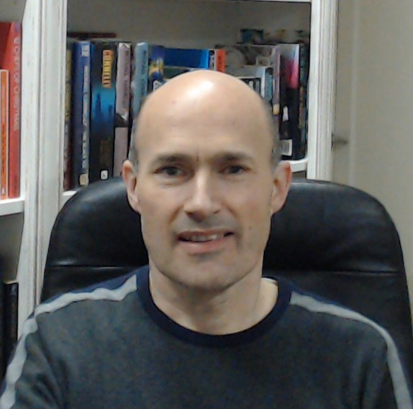
Daren Fulwell
Network Architect, MAG
#init6 co-founder and CCIE Advisory Council member since 2018.
A veteran of 20+ years of network support, implementation and design, working in all sectors. Passionate about good network design, mentoring and helping the next generation networkers Do The Right Thing.
Notes:
Note: This is a Sample Speaker Bio Slide.

Slide 4


Slide 5



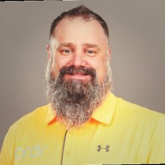


Rick Bauer
John Gibbs
Daren Fulwell
John Amer
Rick Koenig Jr
Derek Winchester
Abdel-Moniem e. Rezk
Wolfram Seidel
Notes:
CCIE Advisory Council
Development of new generation CCNA, CCNP, CCIE and DevNet certs
Recognised a need to teach old dogs new tricks – we are all “old dogs”
Advocates and mentors for the learning needed to pivot to remain “relevant” (even though fundamentals will *always* be relevant)
Init 6 – Linux command to reboot
#init6 – reboot networkers
Youtube channel, talks like this, soon to be podcast to connect with people wanting to learn the new ways to share the journey
First phase has been engaging with DevNet around the new cert programme
Much has been learnt through our first 13 video interviews, discussions and demos
Wanted to show how our journey – with the support of the DevNet community – is bearing fruit in our own experience

Slide 6



Three Main Lessons Learned
Walk – Run – Fly
Use cases
Stand on the shoulders of giants!
Walk
Run
Fly
Notes:
The three main lessons we have learned so far:
DevNet philosophy of Walk-Run-Fly – build up capability in stages:
Use APIs to get useful data out of network
Use that data, collected from across the network and elsewhere, to gain actionable insight
Execute automated actions based on the insight (eventually closed loop)
Use case is scoped and well understood – start small with well-known repeatable activity, and build modular so it can be grown
Stand on the shoulders of giants – don’t reinvent wheel – understand what is available in repositories and re-use (subject to licence of course).
Github
DevNet Code, Automation Exchanges

Slide 7

























9
8
7
6
5
4
3
2
1
Notes:
Meet Holly. She’s a machine operator in a factory – looking great in her hi-vis! – and she’s responsible for the machine that boxes up widgets and gets them ready for shipping out. As you can see, during normal operation, the process works smoothly – Holly starts the machine, boxes are stacked up neatly, then Holly turns off the machine, boxes are loaded onto the trucks and away they go. The company that runs the factory has installed a wireless network to ensure staff are always connected and the machines are able to be centrally monitored and controlled.

Slide 8
Process Summarization
By automating the Access Points to turn on/turn off manufacturing equipment based on physical proximity the support personnel can focus on the tasks required for revenue generating processes.
This creates efficient use of time on task and aids the bottom line
Additional benefits include green approach with a reduced electrical use
Speed to market and reduced overhead: win-win-win scenario
Client gets faster service
Corporation reduces overhead and generates more margin
No wasted effort for the operator

Slide 9
Demonstration
Notes:
Sacrifices made to demo gods
DF to join Webex on both phone and PC
DW can run script or DF can run on Linux machine
DF leaves room in darkness, mutes laptop
DF runs video from phone – goes to make a brew in the kitchen – returns to office and light comes on ;)
DW can show Meraki dashboard and changes being made dynamically, and WxT chat
Small leap of imagination: large number of Aps, query (x,y) location within space instead, and use ceiling switches to control PoE office lighting

Slide 10
Python Script review
#!/usr/bin/env python3
# modules to import include API modules for Meraki and Webex Teams
import time
from meraki import DashboardAPI
from webexteamssdk import WebexTeamsAPI
# script installer should ensure MERAKI_DASHBOARD_API_KEY environment variable set/exported
# then we can spark up an instance of the API for query
dashboard=DashboardAPI()
# script installer should ensure WEBEX_TEAMS_ACCESS_TOKEN environment variable set/exported
# then spark up an instance of the API for query
webexTeamsRoom=WebexTeamsAPI()
# assign global variables, pre-captured from the API using Postman and ready for the API calls
myNetwork=<meraki network ID string>
switchSerial=<meraki switch serial no string>
poePort=8
myWebexRoom=<WxT room ID string>
# assign globals relating to the endpoint to be used for proximity check
operatorClientName='iPhone'
# first time run status
assocStatus=''
# infinite loop - determine operator location and act accordingly
while True:
Notes:
while True:
Meraki API call to retrieve wireless client events
if event has occurred since last poll:
if disassociation event:
Meraki API call to change PoE state to off
message="client left station"
elif association event:
Meraki API call to change PoE state to on
message="client arrived at station"
Webex API call to send message to room
delay 10 seconds

Slide 11
Python Script continued
# fetch AP associate and disassociate events for operator's wireless client
associateEvents=dashboard.events.getNetworkEvents(myNetwork,productType="wireless",clientName=operatorClientName,includedEventTypes="association")
lastAssocTime=associateEvents['events'][0]['occurredAt']
disassociateEvents=dashboard.events.getNetworkEvents(myNetwork,productType="wireless",clientName=operatorClientName,includedEventTypes="disassociation")
lastDisAssocTime=disassociateEvents['events'][0]['occurredAt’]
# catch last iteration association status
prevAssocStatus=assocStatus
# if the most recent status is to disassociate then set status variable
if lastDisAssocTime > lastAssocTime:
assocStatus='DISASSOCIATED'
# and if this is different from the previous status, then trigger a config change in the Meraki dashboard for the PoE switch port, and Webex Teams messages
if prevAssocStatus != assocStatus:
webexTeamsRoom.messages.create(roomId=myWebexRoom,text=time.ctime()+' - Operator is leaving the vicinity of the machine')
portStatus=dashboard.switch_ports.updateDeviceSwitchPort(switchSerial,str(poePort),name="Light Off",poeEnabled=False)
webexTeamsRoom.messages.create(roomId=myWebexRoom,text=time.ctime()+' - Machine shutdown sequence activated')
# otherwise if the most recent status is to associate then set status accordingly
else:
assocStatus='ASSOCIATED'
# and if this indicates a change in location, then trigger the config change in the Meraki dashboard and notify the Webex Teams room
if prevAssocStatus != assocStatus:
webexTeamsRoom.messages.create(roomId=myWebexRoom,text=time.ctime()+' - Operator is returning to the vicinity of the machine')
portStatus=dashboard.switch_ports.updateDeviceSwitchPort(switchSerial,str(poePort),name="Light On",poeEnabled=True)
webexTeamsRoom.messages.create(roomId=myWebexRoom,text=time.ctime()+’ – Activating Machine startup sequence')
# wait 5 seconds before polling location status again
time.sleep(5)
Notes:
infinite loop:
retrieve operative location
if operative has left the machine location:
power down machine
send notification
elif operative has returned to machine location:
power machine up
send notification
wait 10 seconds

Slide 12
Summary
Start Small! Walk-Run-Fly
Community
Old dogs can learn new tricks!
Notes:
Develop logic on a small-scale use case and build on it
Contribute and exchange code and use cases – learn from the community
Don’t be scared!
With fundamental network skills, and the support from #init6 and many others …
We are fanatical lifelong learners, seems to be a trait of network folks!
The DevNet Certs give you a structure for your learning

Slide 13
Thanks! Questions?

Slide 15








Notes:
Imagine a manufacturing facility which runs 24/7 and uses wifi throughout to provide connectivity to the machines but also to personal handheld devices. The facility is only manned to reduced staff levels outside core hours, so if deliveries need to be handled, or phone calls answered, a member of the team needs to leave the manufacturing floor and the machine she is responsible for operating for a period of time. To ensure health and safety of the workforce, the operative needs to stop operation and shut down the machine while she attends to the other activity - a manual step which can be skipped or forgotten when time is short.
The wireless network can help provide a solution to that. Each client location could be tracked and that location data checked to see if the technician is at her designated machine. If not, the power can be automatically shut down to her machine until she returns. Notifications could be sent in real time to the plant monitoring system, and data recorded for reporting purposes, showing the productivity impact of technicians having to leave their posts.
Safety of operatives is improved, individual productivity tracked and information gathered in understanding the impact of the out-of-hours staffing levels - a lot more than just providing wireless connectivity!

